Slide 1





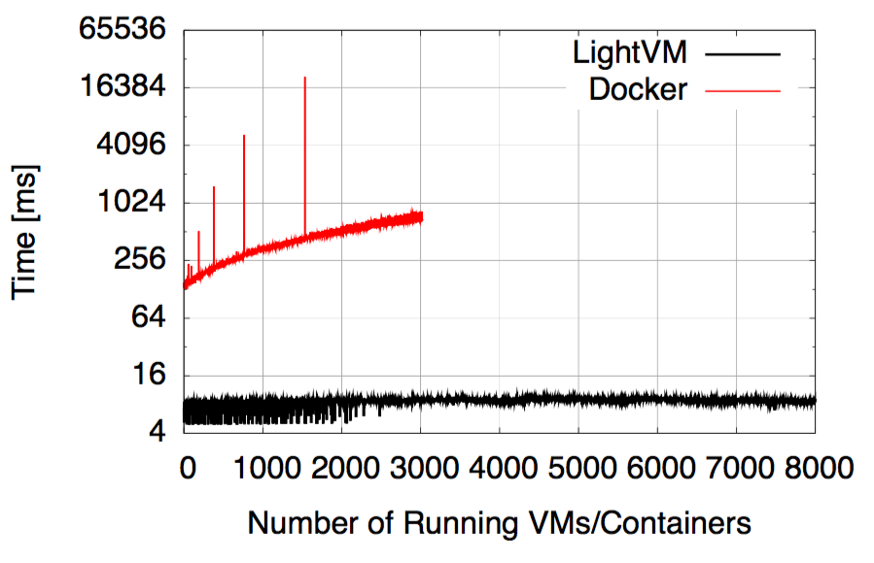
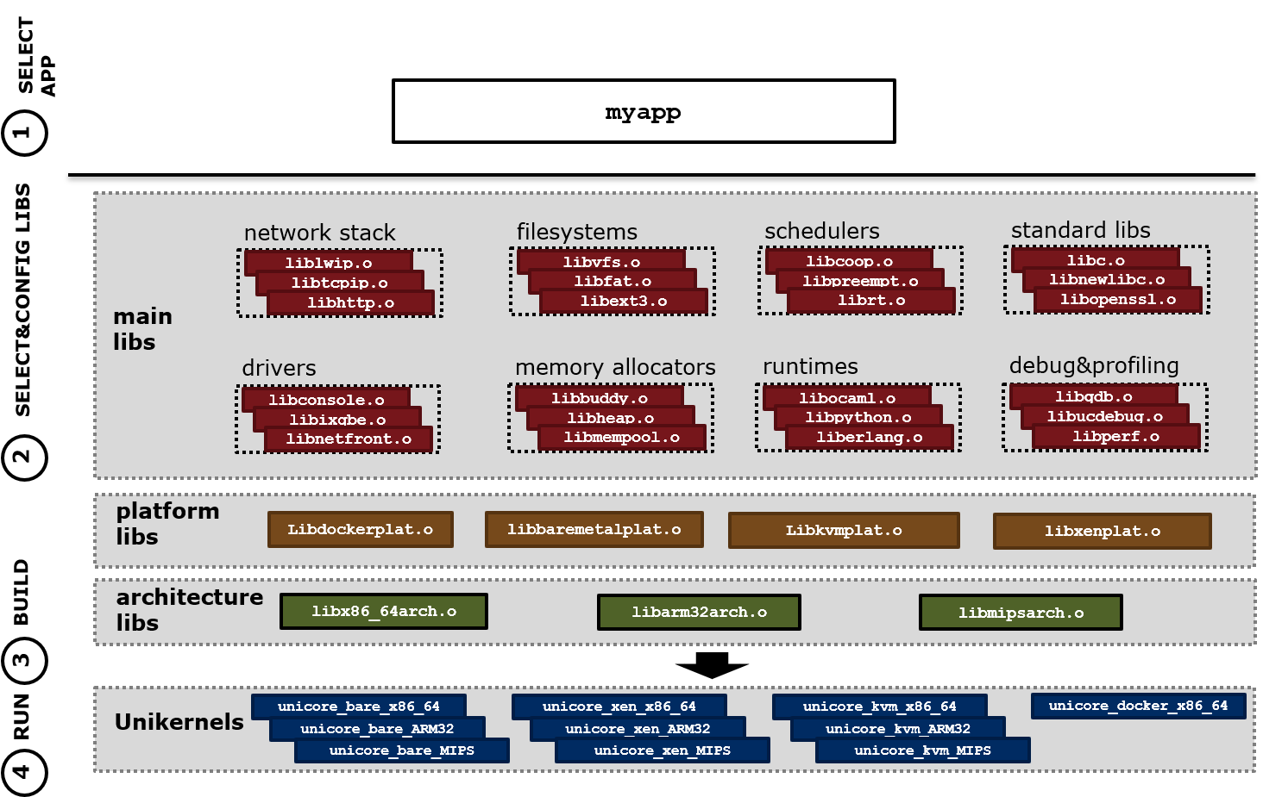

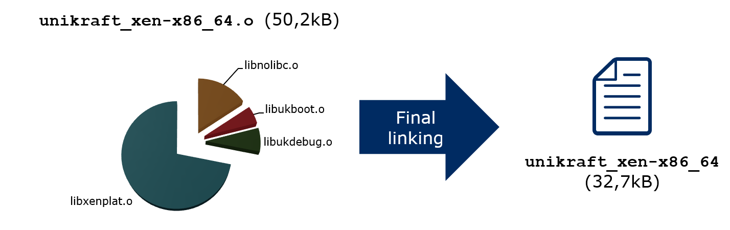



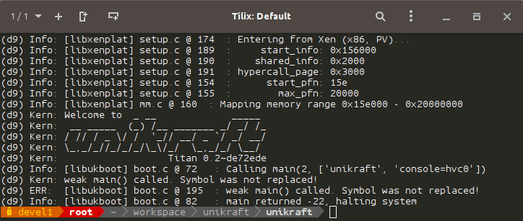
Unikraft – Unleashing the Power of Unikernels
Costin Lupu, Razvan Cojocaru, Costin Raiciu
University Politehnica Bucharest
Containers and VMs or best of both?
Isolation vs Performance
Unikernel benefits
Containers
VMs
Fast instantiation, destruction and migration time
  10s of milliseconds or less (and as little as 2.3ms)
  (LigthVM [Manco SOSP 2017], Jitsu [Madhvapeddy, NSDI 2015])
Low memory footprint
  Few MBs of RAM or less (ClickOS [Martins NSDI 2014])
High density
  8k guests on a singlex86 server (LigthVM [Manco SOSP 2017])
High Performance
  10-40Gbit/s throughput with a single guest CPU
  (ClickOS [Martins NSDI 2014], Elastic CDNs [Kuenzer VEE 2017])
Reduced attack surface
  Small trusted compute base
  Strong isolation by hypervisor
Lightweight
Strong isolation
Iffy isolation
Heavy weight
Unikernels
Purpose-build → only what the app needs
One application → single address space
2
0
2
0
Unikernel specialization and performance
Specialization in Unikernels
Instantiation Times with LightVM
User Application
3rd Party Applications
Libraries
Services
Kernel
unused!
unused!
0
0
2
2
unused!
general-purpose OS
unikernel
But… manually built (until now)
Unikraft – Framework for building unikernels
Unikraft libraries
Example system
Python Interpreter Unikernel for KVM on x86_64
libpython.o
liblwip.o
Unikernel
liballocbuddy.o
libconsole.o
libschedcoop.o
libfilesystem.o
0
libkvmplat.o
0
2
2
libx86_64arch.o
Other examples:
    NFV Unikernels (Click OS)
    PyTorch
    Nginx
    Redis
Everything is a library!
A baseline example…
Join Us, we’re Open Source!
Xen PV x86_64 binary
Boots and prints messages to debug console (with min. 208kB RAM)
Unikraft got released as Xen incubator project
  OpenSource development under Xen and LinuxFoundation umbrella
Have look on the Wiki
  http://www.unikraft.org/
Drop us an mail
  minios-devel@lists.xen.org
Join our IRC channel
  #unikraft on Freenode
0
0
Sponsored by NEC Corporation
2
2

