Slide 1
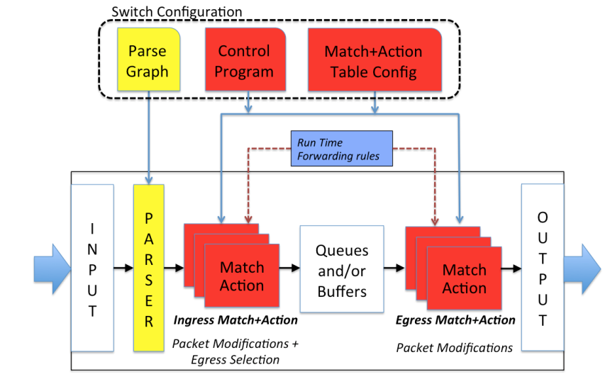
Debugging P4 programs with Vera
Radu Stoenescu, Dragos Dumitrescu, Matei Popovici, Lorina Negreanu, Costin Raiciu
University Politehnica Bucharest
SOFTWARE DEFINED NETWORKS:
OPEN FOR PROGRAMMABILITY, OPEN FOR BUGS
Legacy network devices
P4 device
Control plane
BGP, OSPF, EIGRP, …
Controller
Centralized,
X86 programmable
0
Programmable data pane
Data plane
ASIC implementation
0
Programmable
P4 switch API
2
2
PROGRAMMING MODEL FOR P4 DEVICES
P4 device overview
P4 quirks
Parse-able input space decoupled from
processing pipeline.
Invalid packet header access.
Invalid encapsulation.
A P4 program defines a superset of the
actual runtime behavior.
Packet loops, black holes.
Erroneous table states.
2
0
2
0
STATIC ANALYSIS OF P4 PROGRAMS USING VERA
Vera overview
Vera in depth
P4 Controller
Reasoning about switch behavior without
runtime information.
Proactively populate tables with symbolic
entries.
Scaling symbolic execution for tables with
hundreds of thousands of entries.
Use domain specific data structure for
computing path conditions.
Vera
P4 program
P4 table entries
P4 to SEFL Compiler
0
Network
Policy
0
2
2
Symnet verification engine
All possible paths for all possible packets
BUGS CAUGHT USING VERA

Slide 2
P4 packet processing pipeline
Programmable
parser
Packet (byte[])
Programmable
match-action
units
WHAT CAN GO WRONG?
eth
ipv4
Headers
0
2
Payload
eth
ipv4
port
Packet
reassembly
tag
err
bcast
Packet
Metadata

