Slide 1
SAFE-VR System for Ameliorating PHobias, based on Exposure to Virtual Reality
Oana Balan

Slide 2
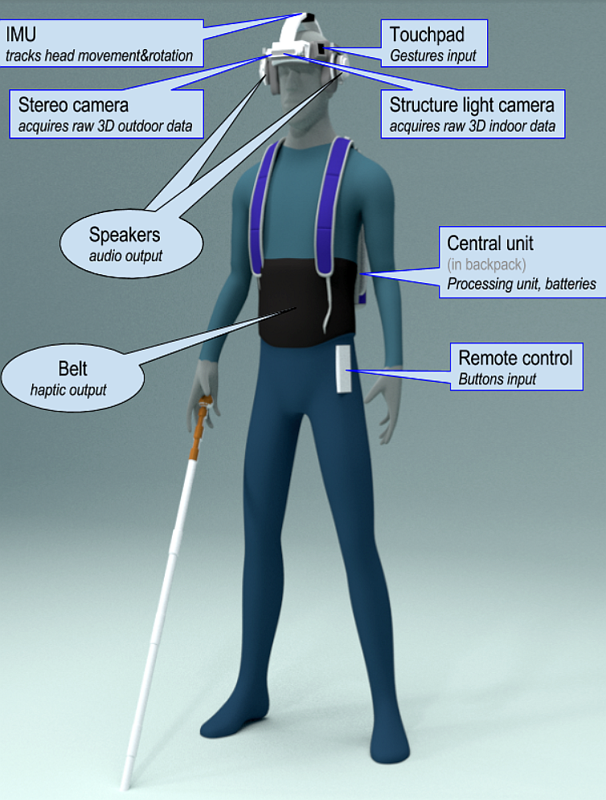
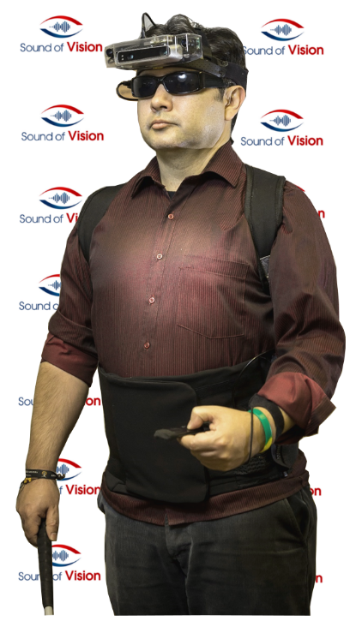
BACKGROUND

Slide 3
THE SAFE-VR PROJECT
13% of the world’s population suffers from a certain type
of phobia
20% of the people affected by phobias take on therapy or
ask for specialized help
Cognitive-Behavioral Therapies (CBT)
Gradual exposure in-vivo

Slide 4
THE SAFE-VR PROJECT
VIRTUAL REALITY advantages:
Immersion
Safety
Greater variety of environments that can be repeated
Visual and auditory stimuli controlled by the therapist
Flexibility
Friendly environment
Low costs

Slide 5
THE SAFE-VR PROJECT
Virtual Reality Exposure Therapy (VRET)
Strong real-life impact
Good stability of results in time
Equal to those obtained in CBT therapies
No difference in the dropout rate between VR and in-vivo exposure

Slide 6
OBJECTIVES

Slide 7
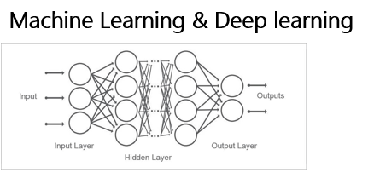
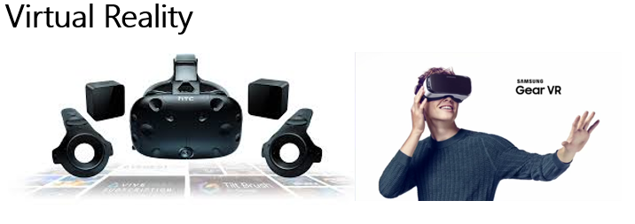
OBJECTIVES

Slide 8
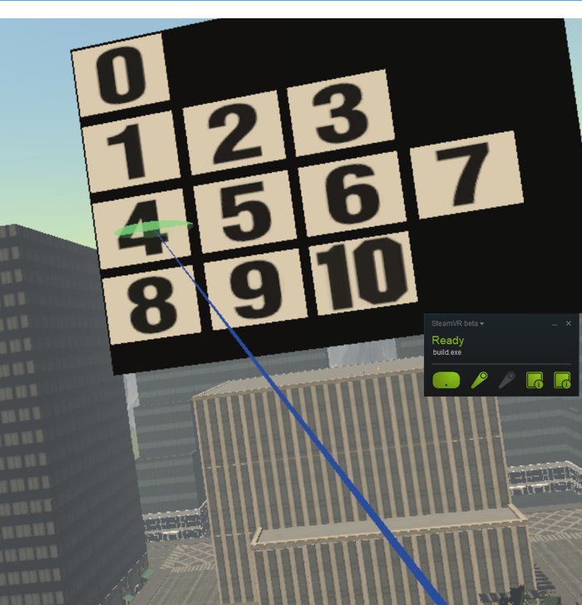
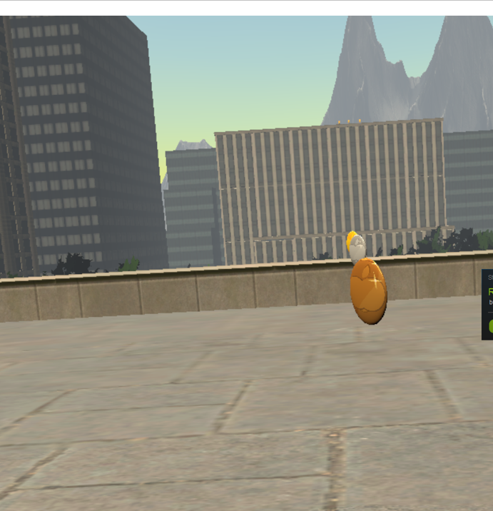

Slide 9
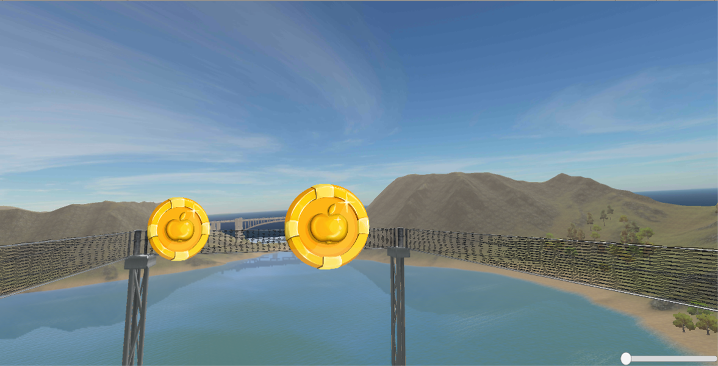

Slide 10
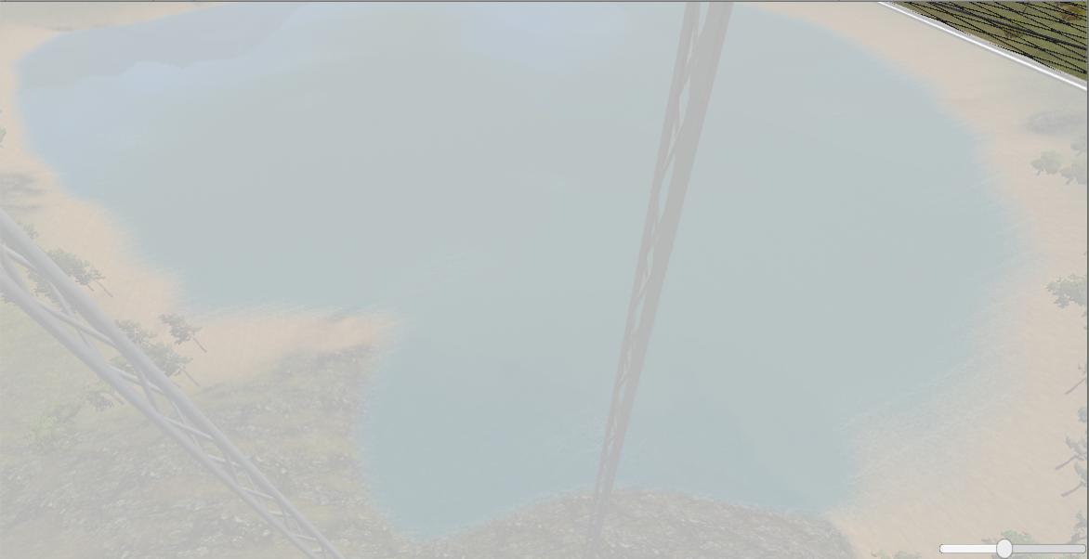

Slide 12
